Slide 1
General Equipment List
The following is a list of all the equipment needed to setup a studio
This list does not include Specialist items such as
Tattoo
Piercing
Permanent Makeup
Microblading
Removal
Sterilization
These are on separate lists

Slide 2
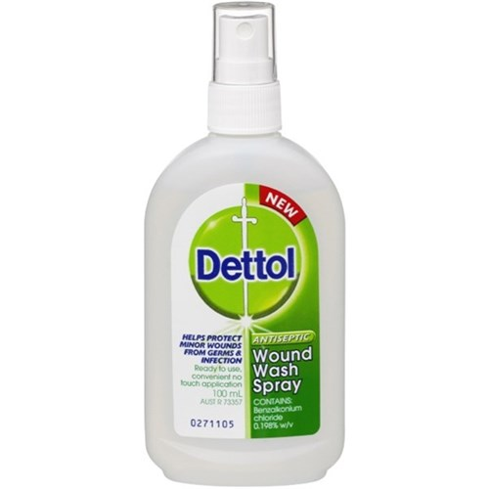
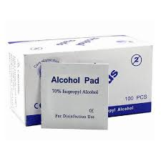
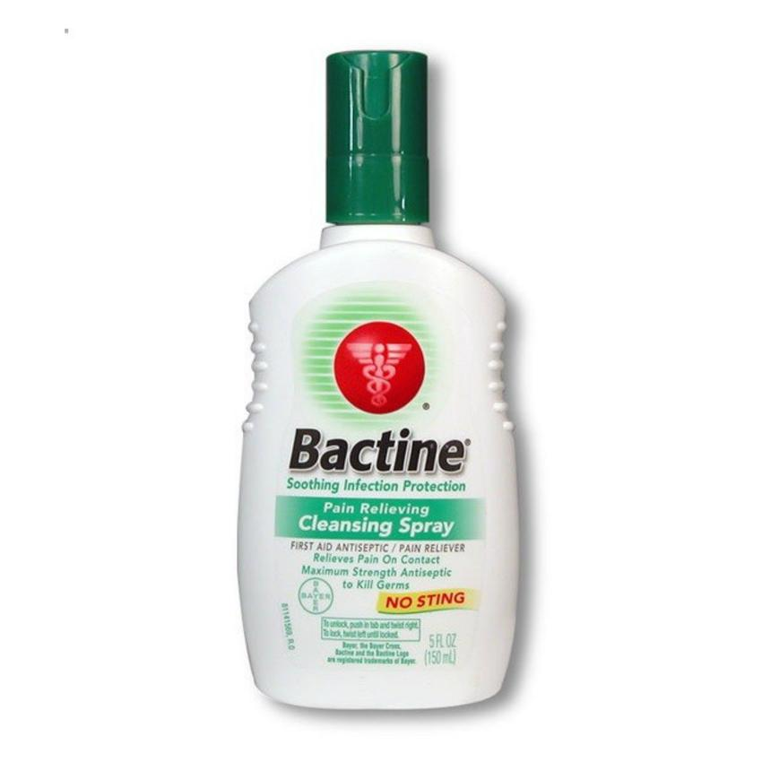
Skin Cleaner / Wash
Pre Procedure
During the procedure
Savlon + Sunlight Antibacterial soap mix
Soap free tattoo wash(recommended)
Bactine Anesthetic wash

Slide 3
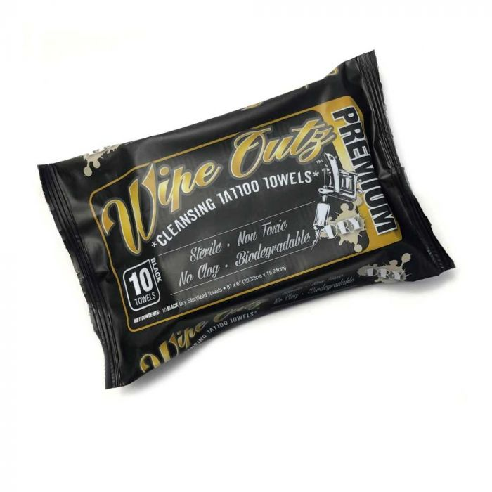
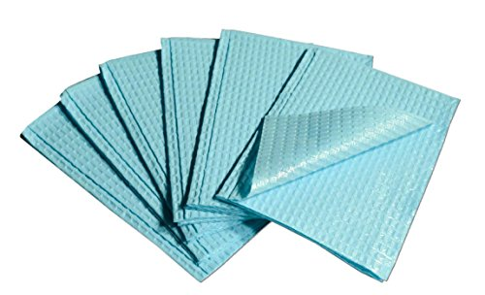
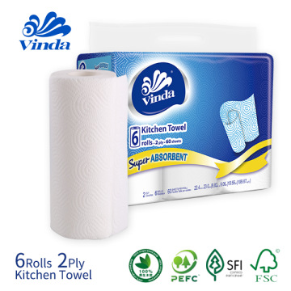
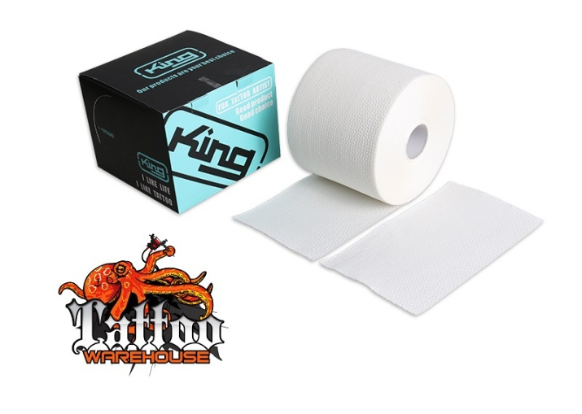
Wipes / Paper towels / Bib
Dentist bib
Wipes

Slide 4

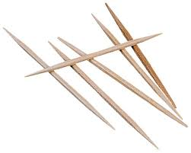
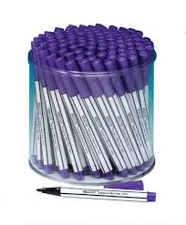
Markers and Tools
Eyeliner and Toothpick
Marker and toothpick
Indelible Pens
Single use (recommended)

Slide 5
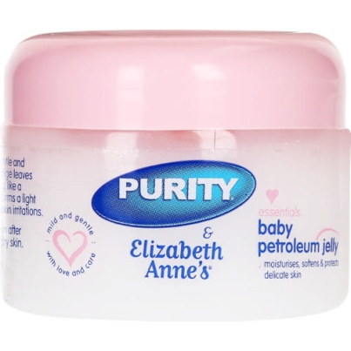
Skin protection
Soft non-fragrance Vaseline
Recipe
Mix Vaseline / Petroleum Jelly and Baby oil

Slide 6
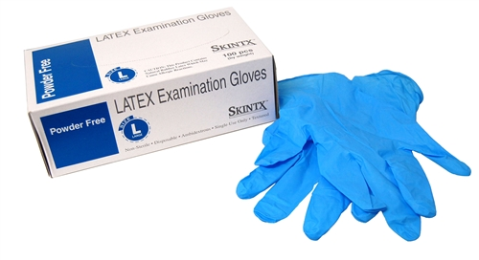
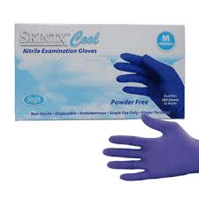
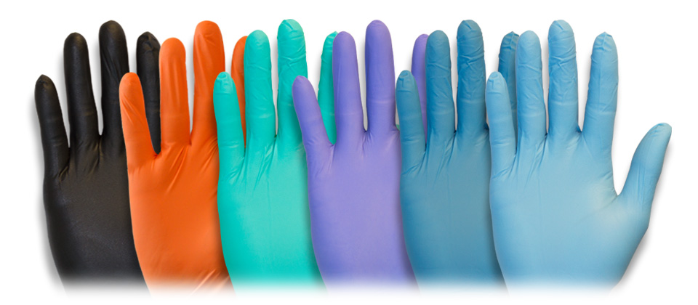
Gloves
Nitrile is preferred

Slide 7
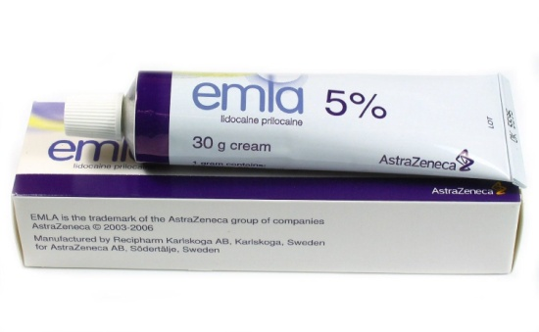
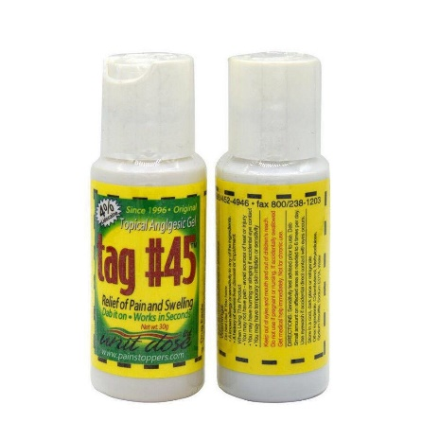
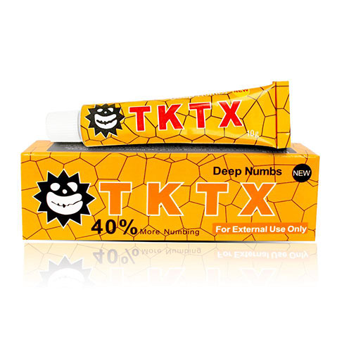
Anesthetics
Pre Anaesthetic
Cling Wrap
Cover anesthetic while it soaks in for 15 min or longer
Apply with earbuds
Procedure Anaesthetics

